Slide 1
Advanced Computer Architecture (ACA 2018)
Prof. SHEN Li
College of Computer, NUDT
Fall 2018

Slide 2
Lecture 08 Branch Predictors
December 5, 2018

Slide 3
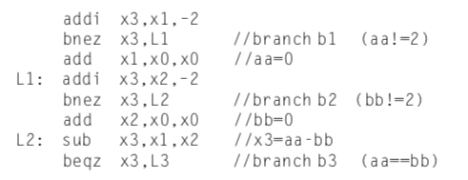
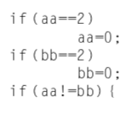
Correlating Branch Predictors

Slide 4
Correlating Branch Predictors

Slide 5
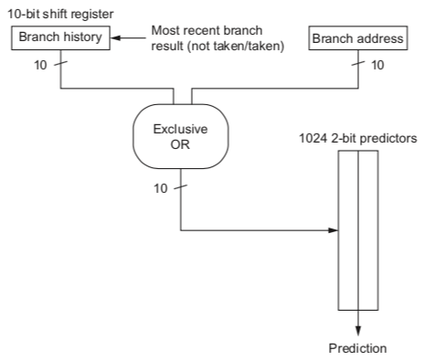
gshare Predictor

Slide 6
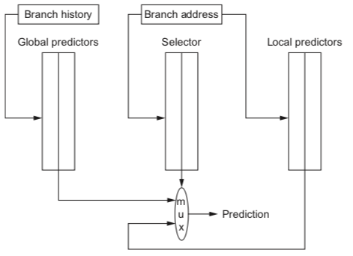
Tournament Predictor

Slide 7
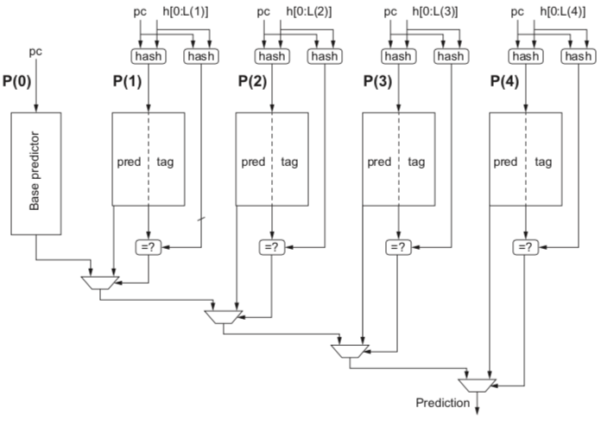
TAGE: Tagged Hybrid Predictors

Slide 8
MIPS Branches and Jumps
Each instruction fetch depends on one or two pieces of information from the preceding instruction:
1) Is the preceding instruction a taken branch?
2) If so, what is the target address?
Instruction Taken known? Target known?
J After Inst. Decode After Inst. Decode
JR After Inst. Decode After Reg. Fetch
BEQZ/BNEZ After Reg. Fetch* After Inst. Decode
*Assuming zero detect on register read

Slide 9
Control Flow Penalty
PC
I-cache
Fetch
Modern processors may have > 10 pipeline stages between next PC calculation and branch resolution!
Fetch Buffer
Decode
Issue
Buffer
Execute
Func.
Units
Result
Buffer
Commit
Arch.
State

Slide 10
Control Flow Penalty
Next fetch started
PC
I-cache
Fetch
Modern processors may have > 10 pipeline stages between next PC calculation and branch resolution!
Fetch Buffer
Decode
Issue
Buffer
Execute
Func.
Units
Branch executed
Result
Buffer
Commit
Arch.
State

Slide 11
Control Flow Penalty
Next fetch started
PC
I-cache
Fetch
Modern processors may have > 10 pipeline stages between next PC calculation and branch resolution !
How much work is lost if pipeline doesn’t follow correct instruction flow?
~ Loop length x pipeline width
Fetch Buffer
Decode
Issue
Buffer
Execute
Func.
Units
Branch executed
Result
Buffer
Commit
Arch.
State

Slide 12
Branch Penalties in Modern Pipelines
A
PC Generation/Mux
P
Instruction Fetch Stage 1
Branch Target Address Known
F
Instruction Fetch Stage 2
B
Branch Address Calc/Begin Decode
I
Complete Decode
J
Steer Instructions to Functional units
Branch Direction &
Jump Register Target Known
R
Register File Read
E
Integer Execute
Remainder of execute pipeline
(+ another 6 stages)
UltraSPARC-III instruction fetch pipeline stages
(in-order issue, 4-way superscalar, 750MHz, 2000)

Slide 13
Multiple Issue Processors
Delivering 4~8 instructions per cycle
Predicting branches well is not enough
Must deliver a high band-width instruction stream
Three concepts to accomplish
A branch target buffer
An integrated instruction fetch unit
Predicting return addresses
We Need
High performance instruction delivery

Slide 14
Branch Target Buffer (BTB)
Find the target PC before ID
Just like a ordinary instruction fetch after a branch
Fields of a BTB
The PC of a branch stores in BTB
The predicted PC (target address) stores in BTB
(An optional field to indicate if the branch is predicted to be taken or not taken)
Also called branch-target cache

Slide 15
How Branch Target Buffer Works
IF: The PC of every instruction is compared against the PC’s in the BTB buffer
If matched meaning the instruction is a branch, the corresponding predicted PC is returned
(If the branch was predicted taken,) the predicted PC is used as the next PC

Slide 16
Branch Target Buffer (BTB)
I-Cache
2^{k}-entry direct-mapped BTB (can also be associative)
PC
Entry PC
Valid
predicted
target PC
k
=
match
valid
target
Keep both the branch PC and target PC in the BTB
PC+4 is fetched if match fails
Only predicted taken branches and jumps held in BTB
Next PC determined before branch fetched and decoded

Slide 17
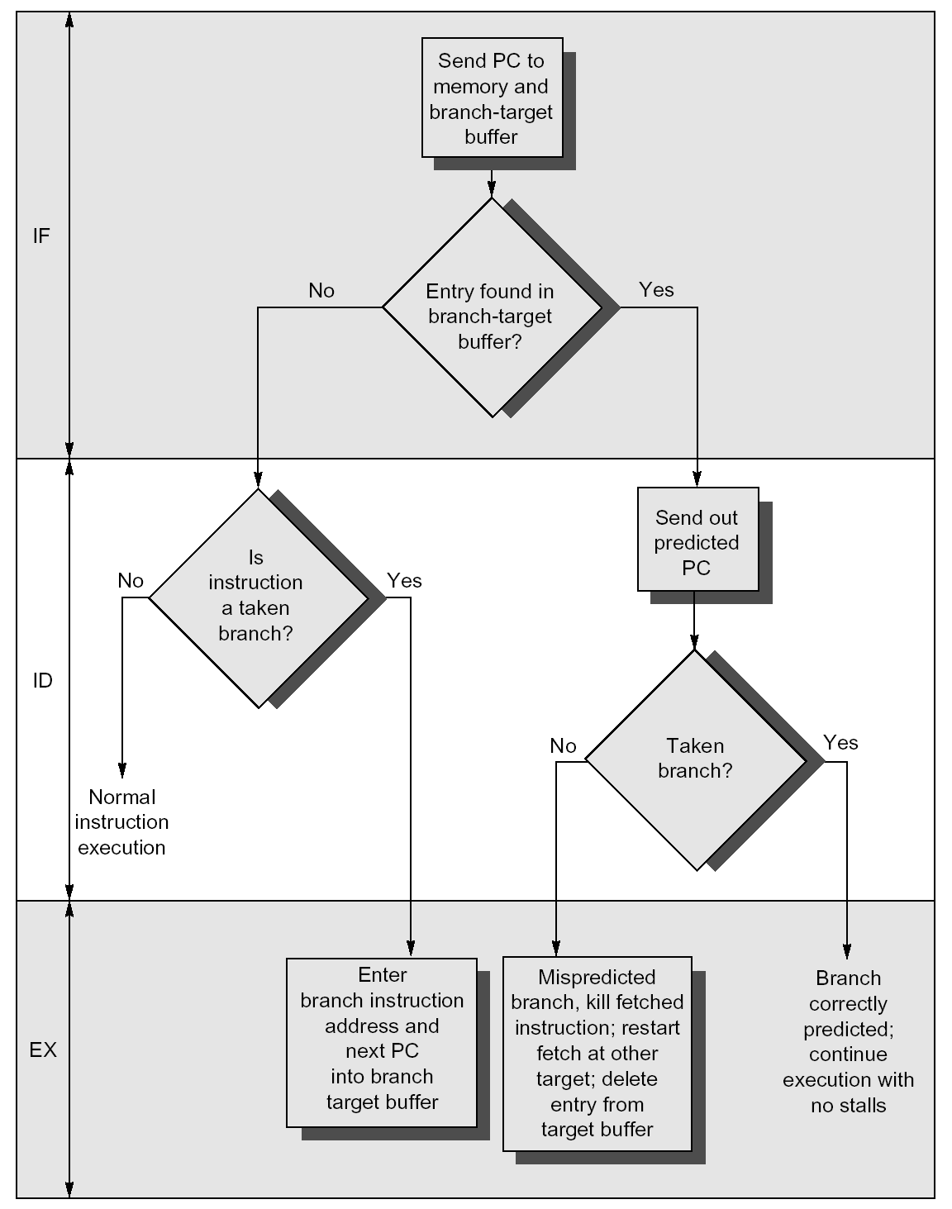

Slide 18
BTB Penalties
Instruction in BTB | Prediction | Actual branch | Penalty cycle
yes | T | T | 0
yes | T | NT | 2
no |  | T | 2
no |  | NT | 0

Slide 19
One Variation of BTB
One or more instructions instead of, or in addition to, the predicted target address
One target buffer or
Two legs
Minimized the times of instruction fetch from memory
Allows a larger BTB

Slide 20
BTB : Structure

Slide 21
BTB : Usage
If a branch is detected and the predicted PC is correct we have a zero-delay or a zero-cycle branch
The IBM RS/6000 and several PowerPC uses this technique of branch prediction
Intel Pentium…

Slide 22
BTB Reduced the Penalty
Fetching instruction from both direction
Adds cost
Need dual ported memory system
It may be the only way to reduce branch penalties
The PowerPC processors in IBM AS/400
Fetching both branch legs

Slide 23
BTB : Example
Consider the example in BPB
Taken 9 and not taken once
Assuming the penalty as the table
Determine the total branch penalty

Slide 24
BTB : Example Assumptions
Prediction accuracy: 90%
For instruction in buffer
Hit rate in the buffer: 90%
For branches predicted taken

Slide 25
BTB : Answer 1/2
Probability (branch in buffer, but not taken)
=Percent buffer hit rate × Percent incorrect predictions
=90% × 10%
=0.09

Slide 26
BTB : Answer 2/2
Probability (branch not in buffer, but actually taken) = 10%
Branch penalty = (0.09 + 0.10) × 2 = 0.38

Slide 27
One Variation of BTB
One or more instructions instead of, or in addition to, the predicted target address
One target buffer or
Two legs
Minimized the times of instruction fetch from memory
Allows a larger BTB

Slide 28
Branch Folder
Branch folding: buffering the actual target instructions to perform an optimization
Branch folder buffers the instructions from the predicated path obtain
Zero-cycle unconditional branch
Zero-cycle conditional branch

Slide 29
Indirect Jumps 1/2
Including in most recent processors, generated in high-level language
SELECT or CASE statement
GOTO statement in FORTAIN-like language
Indirect procedure CALL
Procedure RETURN: 85% of indirect jump in SPEC

Slide 30
Indirect Jumps 2/2
A small buffer of return addresses is used to overcome this problem
Operating as stack has been proposed
Cache the most recent return address
Depth
Cost

Slide 31
Prediction Accuracy (Depth)

Slide 32
Dynamic Branch Prediction Summary
BPB/BHT: 2 bits for loop accuracy
Correlation: recently executed branches correlated with next branch
Either different branches or different executions of same branches
Branch Target Buffer
Include branch address & prediction

Slide 33
BTB vs. BPB
BPB are limited by
Prediction accuracy
The penalty for the missed predictions
BTB accuracy range depending on
The program
Size of the buffer
Typical BTB achieve an 80~95%

Slide 34
Conclusion of Branch Prediction
Prediction accuracy: typical 80 - 90%, depending on
Type of program
Size of buffer
Penalty for misprediction
Fetch both direction: dual-port memory, interleaved cache
Cache multiple paths in the target buffer

Slide 35
Question: Where Can Implement These Functions?
Almost all branch predictions associate with instruction flow
The NPC and its calculation or decision
Fetch or prefetch which instructions
So, the answer is
it must be instruction fetch unit (IFU)

Slide 36
Integrated Instruction Fetch Units
To meet the demands of multiple issue
As a separate autonomous unit that feeds instructions to the rest of the pipeline
Characterizing instruction fetch as a simple single pipe stage
The complexities of multiple issue is no longer valid

Slide 37
Integrates Functions
Integrated branch prediction
Becomes part of the instruction fetch unit
Constantly predicting branches
Drive the fetch pipeline
Instruction prefetch
Deliver multiple instructions per clock
Fetch ahead
Manages the instruction prefetching
Instruction Memory Access

Slide 38
Instruction Memory Access
Prefetching
Encapsulates complexity: hide the cost of crossing cache blocks multiple instructions fetch
Buffering
Provide instructions to the issue stage as needed with the quantity

Slide 39
Next PC: A Short Review
About NPC, we have learnt
PC+1 (PC+4)
BPB
BTB
Almost all branch predictions associate with instruction flow
The NPC and its calculation or decision
Fetch or prefetch which instructions

Slide 40
Integrates Functions
Instruction fetch unit (IFU)
Integrated branch prediction
Becomes part of the instruction fetch unit
Constantly predicting branches
Drive the fetch pipeline
Instruction prefetch
Deliver multiple instructions per clock
Fetch ahead
Manages the instruction prefetching
Instruction Memory Access

Slide 41
Lecture 09 The Limitations of ILP
December 5, 2018

Slide 42
Critical Question
How much ILP exists
Long-term ability to enhance performance at rate that exceeds the increase in speed of the base IC technology
What is need to exploit more ILP
Both for computer and compiler design
How much ILP is available using existing mechanisms with increasing hardware budgets?

Slide 43
New ILP Techniques ???
Need to invent new HW/SW mechanisms to keep on processor performance curve?
E.g.
Intel MMX, SSEx, AVX (Streaming SIMD Extensions):
64 bits in ints
128 bits in floats, including 2 64-bit FPs
Power/PowerPC
Sparc
Streaming – DSP applications

Slide 44
How to Study ILP?
Making a set of assumptions
How much parallelism is available under these assumptions
Making the fewest assumptions
It is completely unrealizable in ultimate hardware
The affection on the compiler and hardware design

Slide 45
HW Model: An Ideal Processor
1. Infinite number of virtual register
Unlimited register renaming
No name (WAW and WAR) hazards
2. Perfect branch prediction
All conditional branch are predicted exactly
3. Perfect jump prediction
Perfect speculation and unbounded ROB
4. Perfect alias analysis
5. Perfect cache
All memory accesses take 1 clock cycle

Slide 46
These Assumptions Means
Eliminate all name dependences
Assumptions 1 (registers) and 4 (memory)
Eliminate all control dependences
Assumptions 2 and 3
Any instruction can immediately execute just following which it depends on
Real dependences are ideally processed
A processor that can issue an unlimited number of instructions at once looking arbitrarily far ahead in the computation

Slide 47
Perfect Processor HW Model
Functions | Model | Power 8 (2014)
Instructions Issued per clock | Infinite | 10
Execution units | Infinite | 16
Instruction Window Size | Infinite | Hundreds
Renaming Registers | Infinite | 48 integer+40 Fl. Pt. (?)
Branch Prediction | Perfect | 2% to 6% misprediction
Cache | Perfect | 64KD, 32KI, 512KB L2, 8MB L3 (one core)
Memory Alias Analysis | Perfect | ??

Slide 48
What the Perfect Processor Must Do?
Look arbitrarily far ahead to find a set of instructions to issue
Determine all register dependences
Determine all memory dependences
Avoid all registers WAW and WAR hazards
Predict all branches
Enough FUs for ready instructions to issue

Slide 49
ILP in a Perfect Processor (SPEC92)
instructions issued per cycle

Slide 50
The Factors We are Concerned
The instruction windows
Branch prediction
The effects of register number
Alias analysis
Ways(number) of instruction issue

Slide 51
Instruction Windows
The set of instructions examined for simultaneous execution
Limits the max number of instructions for issue
Window size: hundreds, 2010
About 2450 comparisons for size 50 (900 for 30)
IBM Power5: over 200 instructions in flight
Issue 4 inst./clk to 6 executions
88 integer and 88 floating points registers for renaming

Slide 52
Complexity of Instruction Windows
To determine n issuing register-register dependences, requires comparisons
2(n-1) comparisons for the 1st instruction
2(n-2) for the 2nd
…
Total is
2(n-1) + 2(n-2) + … + 2 = n(n-1) = n^2 + n
4 million for 2000 instructions
Recent machine: several windows
2~8 windows

Slide 53
Limits to ILP HW Model
Functions | Real Model | Ideal Model
Instructions issued per clock | Infinite | Infinite
Instruction window size | Infinite, 2K, 512, 128, 32 | Infinite
Renaming registers | Infinite | Infinite
Branch prediction | Perfect | Perfect
Cache | Perfect | Perfect
Memory alias | Perfect | Perfect

Slide 54
Limitation of the Window Size
instructions issued per cycle

Slide 55
Limitation of the Window Size
instructions issued per cycle

Slide 56
Limitation of the Window Size
instructions issued per cycle
The amount of parallelism uncovered falls sharply with decreasing instruction windows size

Slide 57
Branch and Jump Prediction 1/2
Perfect
Perfectly predicted at the start of execution
Tournament-based branch predictor
2^13 (8K) entries, three 2-bit fields
correlating 2-bit predictor, with global history
noncorrelating 2-bit predictor
2-bit selector: correlating/noncorrelating

Slide 58
Branch and Jump Prediction 2/2
Standard 2-bit with 512 entries BPB
16 entries to predict returns, in addition
Static
Using profile history of the program by compiler
None
Jumps are still predicted

Slide 59
Limits to ILP HW Model
Functions | New Model | Model
Instructions issued per clock | 64 | Infinite
Instruction window size | 2048 | Infinite
Renaming registers | Infinite | Infinite
Branch prediction | Perfect vs. 8K Tournament vs. 512 2-bit vs. profile vs. None | Perfect
Cache | Perfect | Perfect
Memory alias | Perfect | Perfect

Slide 60
Branch and Jump Prediction
instructions issued per cycle

Slide 61
Branch and Jump Prediction
instructions issued per cycle

Slide 62
IIPC: Branch and Jump Prediction
No much difference
instructions issued per cycle

Slide 63
Branch Prediction Accuracy

Slide 64
Branch Misprediction Rates

Slide 65
Misprediction Rates

Slide 66
The Effects of Register Number
Ideal processor
Using an infinite set of physical registers
Eliminates all name dependences among register references
Alpha 21264 registers:
32 integer and 32 FP architectural registers
41 integer and 41 FP extended registers
The effect of reducing the number of registers available for renaming
Both the FP and GP registers are increased

Slide 67
Limits to ILP HW Model
Functions | New Model | Model
Instructions issued per clock | 64 | Infinite
Instruction window size | 2048 | Infinite
Renaming registers | Infinite v. 256, 128, 64, 32, none | Infinite
Branch prediction | 8K 2-bit | Perfect
Cache | Perfect | Perfect
Memory alias | Perfect | Perfect

Slide 68
The Effects of Register Number
Instruction issues per cycle

Slide 69
The Effects of Register Number
Instruction issues per cycle

Slide 70
The Effects of Register Number
Instruction issues per cycle

Slide 71
Alias Analysis
Global/stack perfect
Perfect prediction for global and stack
All heap reference are conflict
Inspection
Static determination
None
All memory reference are assumed to conflict

Slide 72
Limits to ILP HW Model
Functions | New Model | Model
Instructions issued per clock | 64 | Infinite
Instruction window size | 2048 | Infinite
Renaming registers | 256 Int + 256 FP | Infinite
Branch prediction | 8K 2-bit | Perfect
Cache | Perfect | Perfect
Memory alias | Perfect v. Stack v. Inspect v. none | Perfect

Slide 73
Effect of Alias Analysis
Instruction issues per cycle

Slide 74
Effect of Alias Analysis
Instruction issues per cycle

Slide 75
Effect of Alias Analysis
Instruction issues per cycle

Slide 76
Dynamic Memory Disambiguation
We must know the memory addresses of all earlier stores that not yet committed
Only a small number of memory references can be disambiguated per clock cycle
The size of the load/store buffers
They determines how much load or store may be moved

Slide 77
Memory Address Speculation
One technique for reducing this limitation on in-order address calculation
No memory dependences exist or uses a hardware to predict if a dependence exists, stalling the load if a dependence is predicted
A mechanism to discover if a dependence truly exists and to recover if so

Slide 78
Realizable Processors Assumptions
Up to 64 instruction issues per clock with no issue restrictions
A tournament predictor with 1K entries and a 16-entry return predictor
Perfect disambiguation of memory references done dynamically
Register renaming with 64 additional integer and 64 additional FP registers

Slide 79
Limits to ILP HW Model
Functions | New Model | Model
Instructions issued per clock | 64 (no restrictions) | Infinite
Instruction window size | Infinite vs. 256, 128, 64, 32 | Infinite
Renaming registers | 64 Int + 64 FP | Infinite
Branch prediction | 1K 2-bit + 16 return | Perfect
Cache | Perfect | Perfect
Memory alias | HW disambiguation | Perfect

Slide 80
Parallelism and Window Size

Slide 81
Parallelism and Window Size

Slide 82
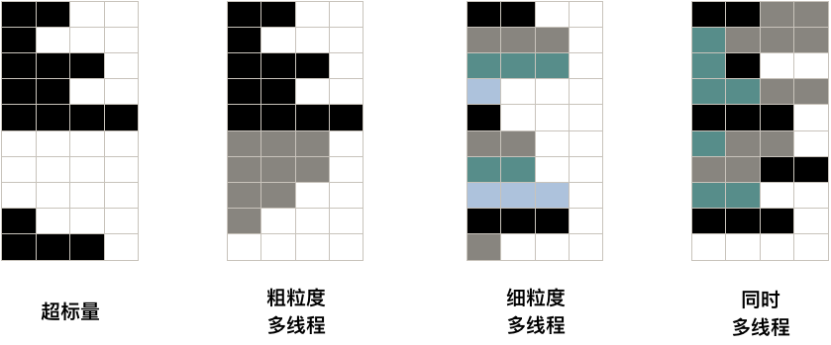
Multi-Threading

Slide 83
Homeworks
Summary
3.3 & 3.9
3.11

